Slide 1
Positive
Classroom
Behavioral
Supports
Supporting &
Responding to Behavior
Evidence-based Strategies for Classroom Teachers
PBIS Teacher
Summer Academy
www.pbiscaltac.org
Notes:
Barb
Inside Cover
o change the image on this slide, select the picture and delete it. Then click the Pictures icon in the placeholder to insert your own image.

Slide 2
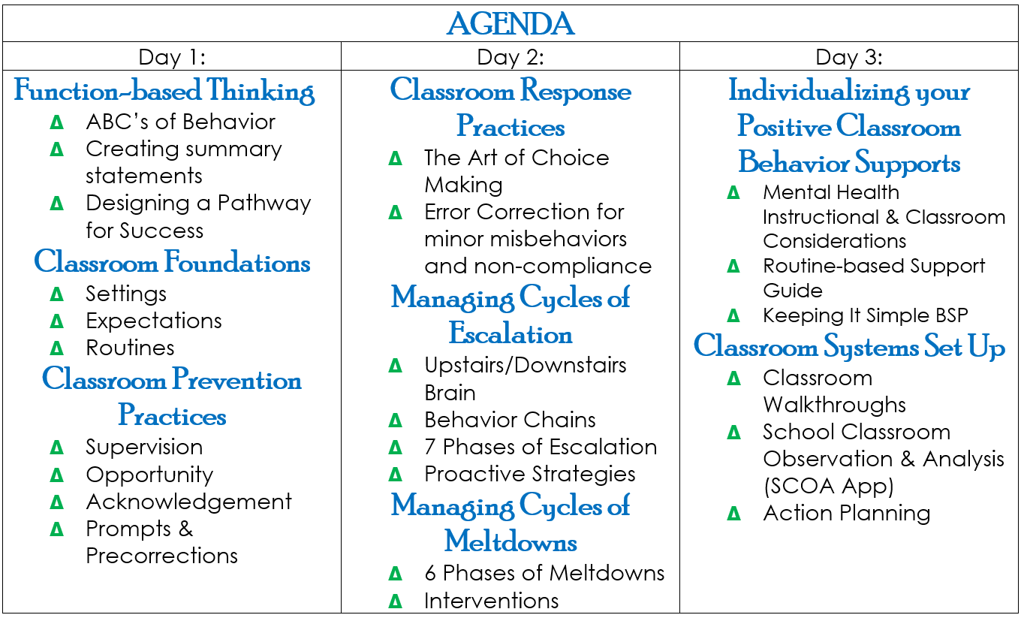
Notes:
Barb
Inside Cover of WB and Table Tent
Routine Based Supports: Practices you want to support, simple behavior support plan focuses on support in early education classrooms
Decision-Making Guide: Responding and Supporting Document
Classroom Walkthroughs: system of how you will support each other
SCOA: tool for you to get feedback on a practice you are targeting

Slide 3
AGENDA-Day 1
PCBS Overview
MTSS-Behavior Framework
Function-based Thinking
ABC’s of Behavior
Classroom Foundations
Settings, Routines, Expectations
Prevention Practices
Supervision, Acknowledgements, Engagement, Precorrections/Prompts
Positive
Classroom
Behavioral
Supports
www.pbiscaltac.org
Notes:
Barb

Slide 4
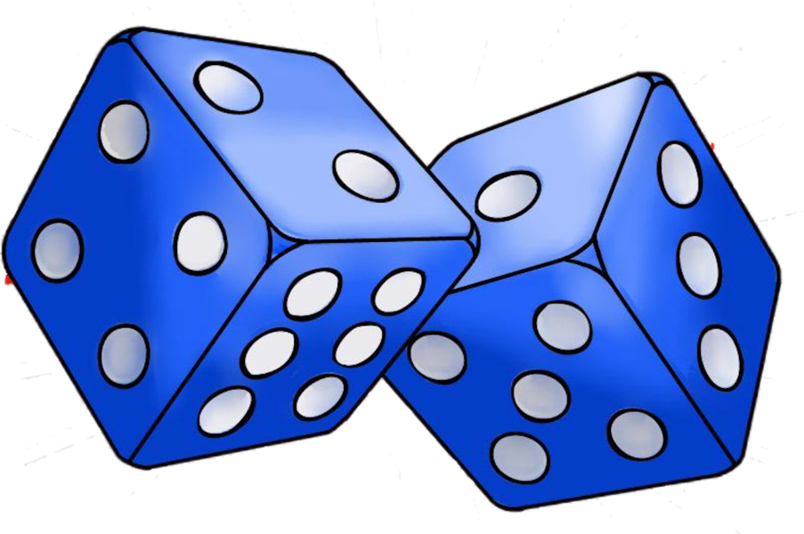
Given today’s agenda:
1 We are excited to share… 2 Something new we hope to learn… 3 We would like to have a deeper understanding of … 4 We would like to feel … 5 We want to experience… 6 We are hoping to leave today with…
Notes:
Kathy: Agenda on Table Tent/give non-examples: Share out and give feedback
Barb: Record each table tent outcome on a large poster paper with blue square and create closing reflections

Slide 5
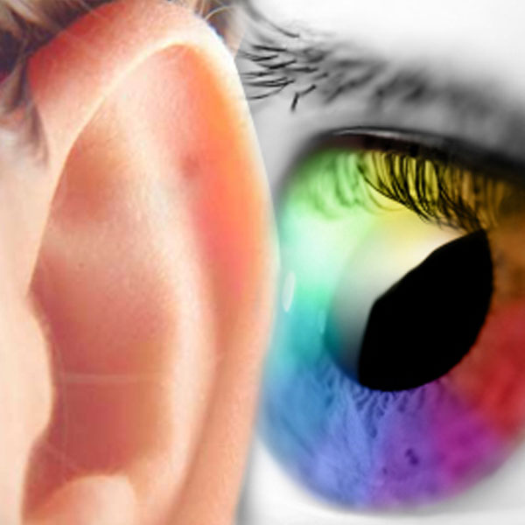
OPERATIONAL
DEFINITIONS
Notes:
Barb: Operationalize on Table Tent-relate to SW PBIS and Classroom PBIS Matrix

Slide 6
Be Respectful
Be a Team Player
Be Amazing
Positive
Classroom
Behavioral
Supports
www.pbiscaltac.org
Notes:
Barb

Slide 7
Multi Tiered Systems of Support
Tier 3
Tier 2
Tier I
Behavioral Framework
Notes:
Kathy
FB-Thinking at all tiers
T1 Example
T2 Example
T3 Example

Slide 8
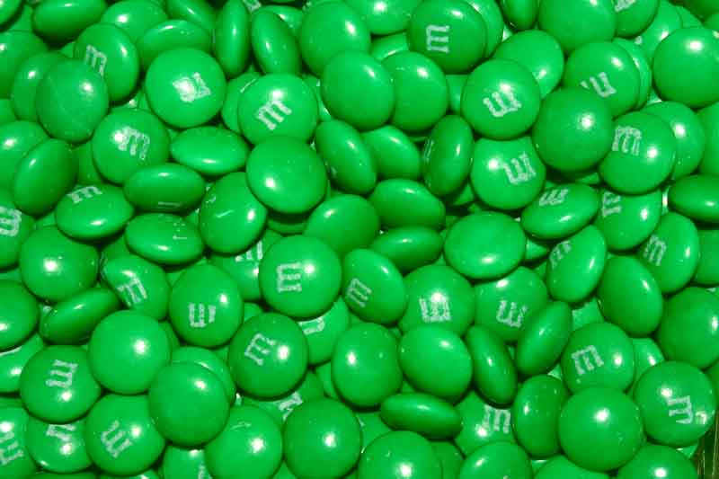
When PBIS is implemented EFFECTIVELY,
80%+ will respond to Tier 1 supports without additional interventions.
Notes:
Overview page 3: SectionALL/Inclusive of everyone – ratio of students to adults

Slide 9
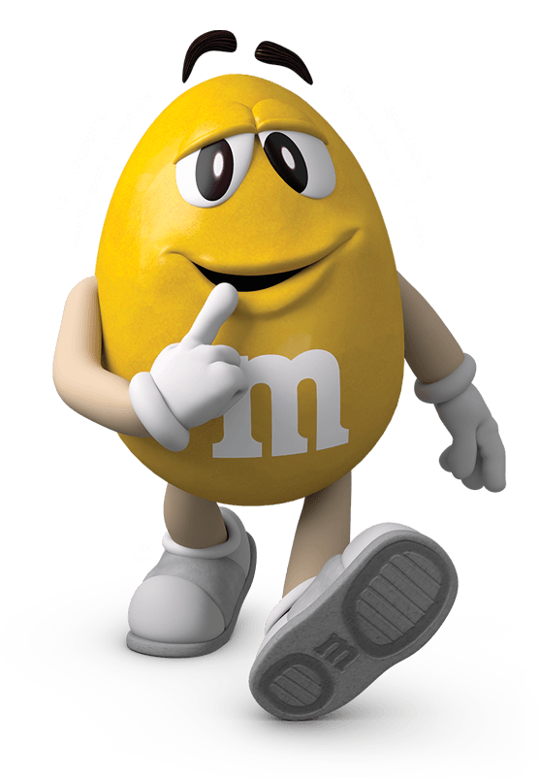
When PBIS is implemented EFFECTIVELY,
10-15% will require Tier 2 interventions.
Notes:
Groups of students / ratio of interventions to coordinators

Slide 10
When PBIS is implemented EFFECTIVELY,
5% may require Tier 3 level
of interventions.
Notes:
One student with multiple adults.

Slide 11
FOUNDATIONS
Settings
Routines
Expectations
PREVENTION
PRACTICES
Supervision
Opportunity
Acknowledgement
Prompts/Precorrections
RESPONSE
PRACTICES
Error Correction
Additional Response Practices
This technical assistance document was adapted from the PBIS Technical Brief on Classroom PBIS Strategies written by: Brandi Simonsen, Jennifer Freeman, Steve Goodman, Barbara Mitchell, Jessica Swain-Bradway, Brigid Flannery, George Sugai, Heather George and Bob Putman, 2015.
Notes:
Barb: Overview Section page 1 of WB
Who has heard of PBIS, keep standing if implementing SW-PBIS
If not, still able to implement Classroom evidence-based strategies
As we (County/Nation) move forward with MTSS-PBIS you will be ahead of the game

Slide 12
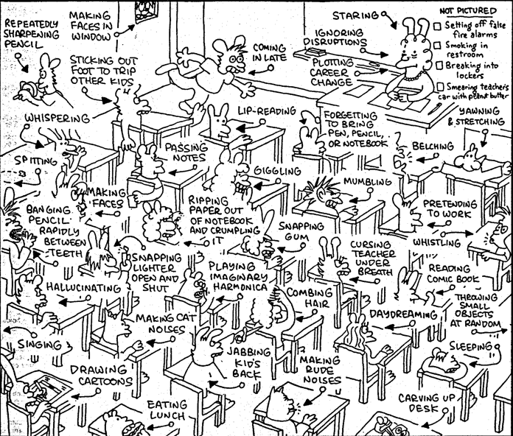
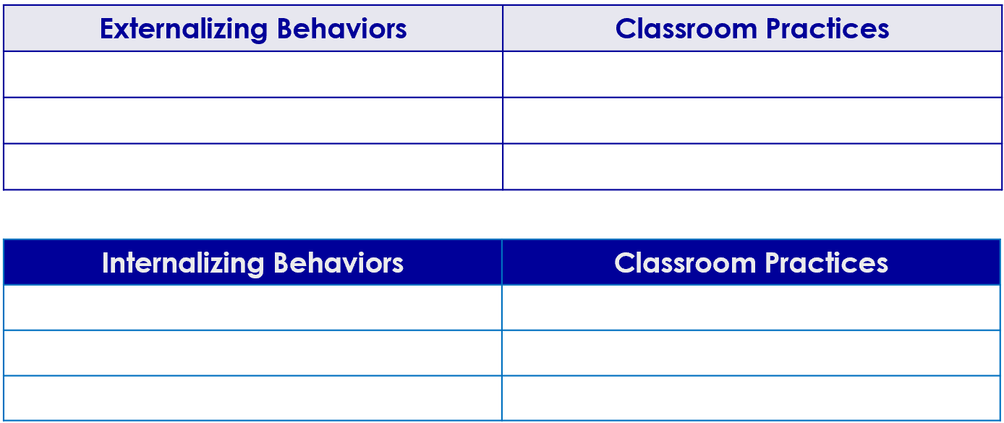
What are some challenging Externalizing behaviors?
What are some challenging
Internalizing behaviors?
What are some positive classroom supports that might reduce the likelihood of
challenging behaviors?
Notes:
Barb: list as many as want on LARGE STICKIE, pick one classroom practice you want to share with the group.
Now pick one of the behaviors and pick one to determine a classroom practice you would use?
10 minute conversation
Internalizing: low activity level, shy, not interacting with peers, avoiding or withdrawn, play alone, fearful manner, not participating, unresponsive, not standing up for self
Externalizing: Aggressive, argue, forcing submission of others, defiance, out of seat, non-compliance, tantrums, disturbing others, stealing, non rule follower

Slide 13
“…the key to successful
classroom management is prevention of problems
before they start,
not knowing how to deal with problems after they have begun.”
Notes:
Barb what you do when you don’t know-just spinning around and whatever you have in our toolbox you grab

Slide 14
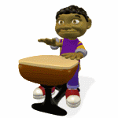
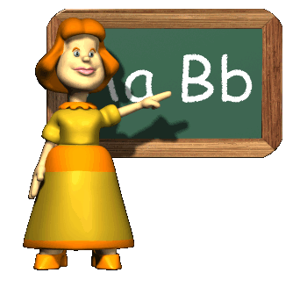
Student Achievement
Good Teaching
Classroom Management
Goal of Teaching
(Gest & Gest, 2005; Stronge, Ward and Grant, 2011)
Notes:
Barb

Slide 15
12% of public school teachers leave within their first 2 years
50% leave within the first 5 years
Boyd, Grossman, Ing, Lankford, Loeb, & Wyckoff, 2011; DeAngelis, & Presley, 2011; Feng, 2006; Henke, Zahn, & Carroll, 2001; Ingersoll, 2001; Ingersol, Merril, May, 2012; Johnson & Birkeland, 2003; Ingersoll & Smith, 2003; Kaiser & National Center for Educational Statistics, 2011; Kukla-Acevedo, 2009; Luekens, Lyter, Fox, & Changler, 2004; Smith & Ingersoll, 2004; Torres, 2012; Zabel & Zabel, 2002)
Notes:
BARB

Slide 16
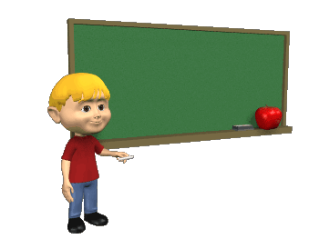
Students benefit when teachers implement evidence-based practices.
Unfortunately, we’re not there yet.
Notes:
Barb-the why
Teachers implement PCBS practices at lower rates than desired.²
Not here, but in this study-add to your repertoire and expertise
Students with challenging behavior experience even less praise, fewer opportunities to respond, more reprimands, and more negative or coercive interactions.³¹ (Simonsen, Fairbanks, Briesch, Myers, & Sugai, 2008)
² (Reinke, Herman, & Stormont, 2012; Scott, Alter, & Hirn, 2011)
³ (e.g., Carr, Taylor & Robinson, 1991; Kauffman & Brigham, 2009; Scott et al., 2011; Sutherland & Oswald, 2005)

Slide 17
implementing within a school-wide multi-tiered behavioral framework directly linking classroom and school-wide expectations and systems;
merging PCBS strategies with effective instructional design, curriculum, and delivery;
using classroom-based data to guide decision making
Positive
Classroom
Behavioral
Supports
Notes:
Barb
To change the image on this slide, select the picture and delete it. Then click the Pictures icon in the placeholder to insert your own image.

Slide 18
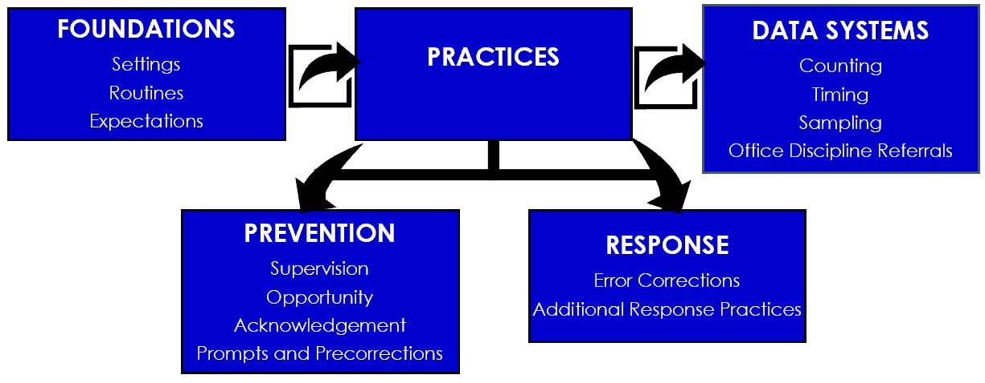
PCBS FEATURES
Notes:
Barb: only doing foundations and moving into prevention
Information go home and read about are pages 3-5

Slide 19
Given what we will cover in the next 3 days:
1 I am excited to share… 2 Something new I hope to learn… 3 I would like to have a deeper understanding of … 4 I would like to feel … 5 I want to experience… 6 I am hoping to leave the PCBS academy with…
Notes:
Kathy – each table writes their responses on poster paper and we consolidate responses for 3 day outcomes

Slide 20
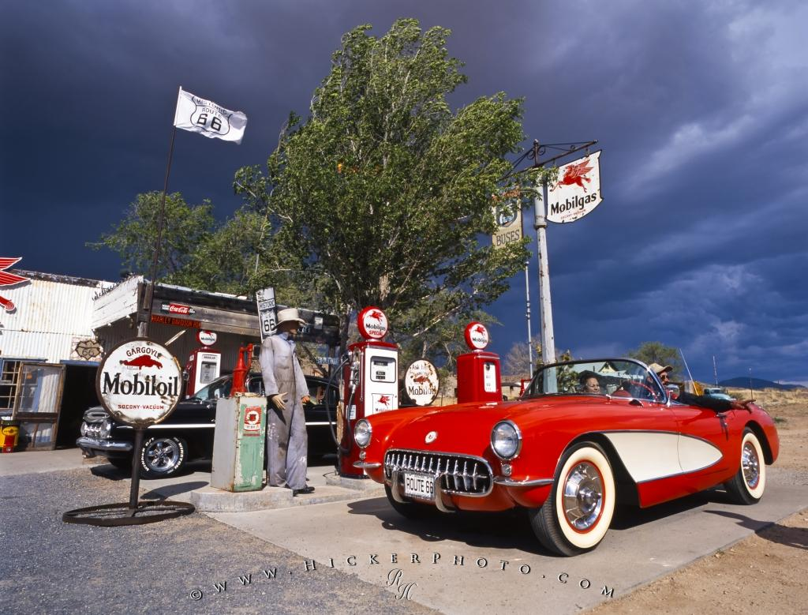
Fueling Up
Please be back
at 10:00

Slide 21
FUNCTION-BASED THINKING FRAMEWORK
Antecedent/PREVENT
Behavior/TEACH
Consequences/REINFORCE
=
MOTIVATION/
FUNCTION
Notes:
Kathy
FB-Thinking at all tiers
T1 Example
T2 Example
T3 Example

Slide 22
My traveling strengths are…
What motivates me to do something that I like is…
What motivates me to do something that I don’t like is…
What motivates me to do something new that I have never done before is..
#1
PACK YOUR BAGS
Page 3
Notes:
Hand up Stand Up
Share your traveling strength
Then move into motivation of anything…(pre-correct)
Report out to each other what you heard partner say
Back to tables

Slide 23
What connections would you make from this experience and working with students in your classroom?
Notes:
Kathy: table conversation

Slide 24
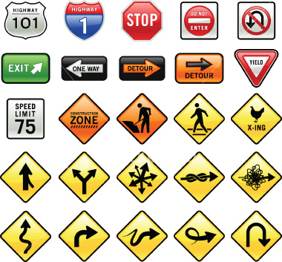
Understanding problem behavior is like…
because…
#2
Road Trip: HWY ABC
ABC
Page 3
Notes:
Barb: use world balls
Instructions: Individually complete the Synectic (metaphor), share at your table, popcorn a few answers from the group or have a team select one from their table to share out with the whole group

Slide 25
Behavioral Science
ANTECEDENTS “Prevent” | BEHAVIOR “Teach” | CONSEQUENCE “Reinforce” “Respond”
Design supportive environments using antecedent strategies promoting a positive and safe school climate and classroom. | Teach positive expectations, self-management and social appropriate peer interactions supporting a positive and safe school climate and classroom for ALL students. | Provide a continuum of positive, intrinsically motivating feedback responses and error correction for ALL students that encourages socially appropriate behaviors.

Slide 26
Points of Interest
ABC
Behavior support is about the design of effective environments..
Without understanding the ABC’s of behavior, an intervention plan is as likely to make a problem worse as to make it better.
Taking the time to understand why a student continues to engage in problem behavior in a specific routine is important…
both ethically and technically.
Page 1
Notes:
Barb
Keep an eye out for these “Points of Interest”
*If we hypothesize that a behavior is due to seeking attention from adults and we implement a plan that gives the student attention (in a socially appropriate way) after we see the behavior occur, but the student was actually exhibiting that behavior to try and avoid the adult’s attention, the student will exhibit the behavior again to get the desired consequence if we guessed incorrectly…and this time the behavior may be worse because it didn’t work in getting the desired response the first time.

Slide 27
What We Know
ABC
At-risk students persevere when they feel supported and successful.
Punishment does not work;
you can’t take away enough.
Punishment destroys their motivation to cooperate. SPECIFIC PRAISE WORKS!.
Teach and practice the behaviors you want.
Page 1
Notes:
Barb

Slide 28
Function-based Thinking
A systematic method to understand and address less complex behavioral issues in the classroom to enhance learning.
A tool that is helpful in gaining AND utilizing information:
What is the behavior?
When does it occur?
What is the motivation for the behavior?
What are the antecedents/consequences?
What replacement behaviors can be taught?
ABC
Page 1
Notes:
Barb

Slide 29
Always Start with the BEHAVIOR
Page 4
2
1
3
AnA
A
B
C
Antecedent
Trigger
Behavior
Consequences
OutComes
Notes:
Kathy
Always start with identifying the behavior first. The “What”
Needs to be stated in an observable/measurable manner
So that anyone could recognize the behavior without a doubt, even if they are unfamiliar with the student.
Always start with only one target behavior at a time. *Remember we want to do the least amount of work for the greatest effect.*
Choose the behavior that occurs the most often or is the most problematic. We call this the target behavior. Addressing the target behavior can meet the student’s needs and eliminate multiple other smaller behaviors.

Slide 30
Observable?
Measurable?
Defined so clearly that a person unfamiliar with the student could recognize the behavior without any doubts?
BEHAVIOR (The What)
Notes:
Kathy
Function Based Thinking
Complete activity 3 on page 8 of the science and logic tab
*remember observable, measurable and clearly defined*

Slide 31
Says the “F-word”
Slams book closed
Has separation anxiety (from parent)
Spacey
Reads 120 wpm
Says she hears voices
Emotionally disturbed
Hits classmates
BEHAVIOR (The What)
Notes:
Kathy
Let’s practice our Function Based Thinking
Thumbs Up if it is a “target behavior” (observable, measurable, clearly defined)
Thumbs down if it is not a “target behavior”

Slide 32
Defining Problem Behavior
NONEXAMPLES | EXAMPLES
Says the F-Word
Spacy
Emotional Disturbed
Separation Anxiety
Hears Voices
BEHAVIOR (The What)
Notes:
Let’s practice our Function Based Thinking
Thumbs Up if it is a “target behavior” (observable, measurable, clearly defined)
Thumbs down if it is not a “target behavior”

Slide 33
Do not go back to your school and tell people who say “bad Behavior” or “problem behavior”
they are wrong.
Just repeat back to them….
“so the behavior you would like to target
for change is ______________
(label the behavior in
measurable and observable teams)
BEHAVIOR (The What)

Slide 34
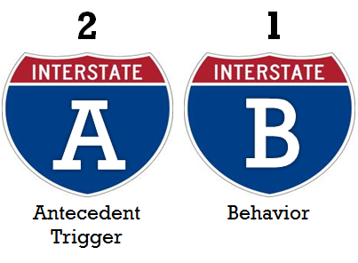
Page 5
ANTECEDENT (Where/When)
Notes:
Barb
Let’s continue our Function Based Thinking. We talked about the “What” (The Target Behavior) now let’s talk about the Where/When (The antecedent)
What is the routine occurring where the behavior occurs most?
transitions, unstructured time, specific content area
What is the antecedent/trigger when the behavior occurs most?
Is it during a certain event, action or object
Small groups, independent work, while correcting last night’s homework
This is the cultural shift, in Tier I we discussed moving from reactive to proactive. Using the ABC’s of behavior assists us in identifying proper prevention practices (antecedents)
Complete activity 4 on page 9 of the Science and Logic Tab

Slide 35
Where(Routine)
When(Antecedent/Trigger)
Student Does (Behavior)
ANTECEDENT (Where/When)
Notes:
ID the routine (where) behavior occurs
Examples: during math class, on playground
ID the event, action, or object occurring right before misbehavior (when) Signals the behavior – sets it off

Slide 36
During Language Arts, when asked to read aloud in class, Teresa gets up and makes jokes.
During
lunch when
told to shut up by a peer, Ben hits the student.
.
During chemistry lab when corrected Jessie starts crying.
ANTECEDENT (Where/When)
Notes:
ID the routine (where) behavior occurs
Examples: during math class, on playground
ID the event, action, or object occurring right before misbehavior (when) Signals the behavior – sets it off

Slide 37
A specific “triggering event”..
Jason hit her when she refused to give him the pen.
A more general “setting event”…
Jason’s hitting is more likely when he is frustrated.
ANTECEDENT (Where/When)
Notes:
Getting more specific about the routine and the problem behavior.
The behavior may occur in more settings, but it is most likely to occur when he is frustrated. Remember, we want to do the least amount of work for the greatest effect.

Slide 38
When he goes to math class and peers tease him about his walk, AJ calls them names and hits them.
During: transition to math class
When …
Peers tease him
about his walk
The student does…
Calls names
and hits.
Notes:
Where would we start?
Yes, the behavior. What is happening… the students calls peers names and hits them
And now…. When does it occur?
Yes, When peers tease him about his walk

Slide 39
Create a simple list of common ANTECEDENTS
to undesired behaviors.
ANTECEDENT (Where/When)
Notes:
Getting more specific about the routine and the problem behavior.
The behavior may occur in more settings, but it is most likely to occur when he is frustrated. Remember, we want to do the least amount of work for the greatest effect.

Slide 40
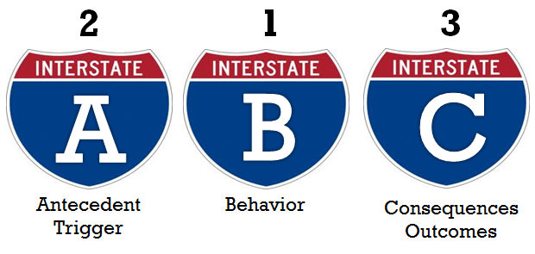
Remember: Always Start with the Behavior
#5
Page 6
What
Where &
When
Why
Define the behavior (What)
Define the routines & antecedent (Where & When)
Find out the outCome of the behavior-what happens right afterword (Why)
Notes:
Kathy
Remember, we always start with the behavior (the what)
Then we move to the ….. Antecedent (where and when)
Finally we move to the consequences…from the students’ perspective (the why)
What happened, for the student, immediately after the behavior occurred
Sometimes we look at this and think, they got a referral to the office so its avoidance of work, but the student may put more emphasis on the fact that they made their peers laugh for a split second before being sent to the office. What is *their* why?

Slide 41
Step 1:
Determine the consequence or outCome
(what happens right after the behavior)
During recess, when peers tease him, Ben hits his peers and
his peers run away.
During reading when asked to read aloud Tammy tells jokes,
the other students laugh, and she is sent to the office.
During Chem Lab, when corrected Jessie starts crying, the teacher stops the lab to comfort her.
CONSEQUENCE (The Why)
Notes:
What happens immediately after the behavior occurs *from the student’s perspective*?
Let’s practice

Slide 42
Joe throws his pencil and rips his paper during math whenever he is given double-digit math problems. This results in his being sent to the office.
Where:___________________
When:___________________________
Student Does:_____________________
As a Result:_______________________
Math Class
Given Double Digit Problems
Throws Pencil/Rips Paper
He is sent to the office.
Notes:
Let’s look at this example.
Which line will we start with?
…. Yes the behavior. What does the student do?
Now let’s identify the Antecedent … where and when
Finally, what is the consequence

Slide 43
Step 2:
Determine the function (or purpose) the behavior is serving for the student
“What is the pay-off?”
Understand from the students’ perspective
“Getting or trying to get or avoid?”
“Most important thing to gain/avoid
by using this behavior?”
CONSEQUENCE (The Why)
Notes:
Positive corrective feedback helps students learn and use appropriate behavior in the future
Punishers may stop the behavior in the moment, but do nothing to change the behavior and make it less likely to occur in the future.
A reinforcer is anything that increases the frequency of a behavior.
When we punish or give negative consequences after a behavior occurs, the behavior occurs more frequently to receive the desired effect and the punishment works as a reinforcer for the target behavior.
Typically, when we talk about consequences people think of punishment. Behaviorally speaking, when we discuss consequences we are thinking about what is specifically maintaining the behavior.
In my classroom, I had students who would act up when we were reviewing homework. Some were trying to avoid the work because they didn’t understand it. They found it was easier to act silly (call friends names, tear up papers, etc) so that their peers didn’t know or notice they didn’t understand the content. I would have those students work in small groups or during breaks to review the concepts for understanding. Other students would exhibit those same behaviors they saw their friends receiving small group instruction and additional support for exhibiting and they did it because they wanted the additional adult attention. Their rates of homework/classwork completion decreased over time to receive that attention and get their needs met. Once I figured out they understood the academic concepts and were avoiding work to gain attention, I set up ne expectations. Work must be completed to come in during break times, they could facilitate a small academic support group for their peers thus giving them the attention they were seeking in a more appropriate manner. This behavior had to be taught, practiced and reinforced before it started to occur with regularity. (Kathy’s story… feel free to add your own experiences)

Slide 44
Problem Behavior
Obtain/Get Something
Sensory Stimulation
Social
Tangible Activity
Escape/Avoid Something
Adult/Peer
Notes:
Remember the functions of behavior
Get/Obtain OR Avoid
Attention- Peer or Adult- Attention- Peer of Adult-
Object/Task Object/Task
Finally, some students have sensory needs. They can exhibit target behaviors in the classroom to fulfil their sensory needs.

Slide 45
To Avoid/Escape
Difficult task
Boring task
Easy task
Physical demand
Non-preferred activity
Peer
Staff
Reprimands
Sensory
To Obtain/Get
Peer attention
Adult attention
Desired activity
Desired object/items
Sensory
Notes:
Don’t forget, sometimes students try to escape/avoid easy tasks as well.
Sometimes students at the secondary level can exhibit target behaviors in 2nd period to avoid something occurring in 3rd period, a mile run, changing in the locker room, a specific teacher/staff member, a student in the hallway during passing period, etc.
In one classroom, a student was an internalizer, he avoided reprimands from the teacher at all costs. His class had a card system, when any student in 2nd grade had to use the restroom during class because they did not use it during their scheduled break times, they had to pull a card. This student would pee their pants silently and his seat would be wet at the end of the day. At the time, the teacher hypothesized that the student was attempting to obtain a desired activity and the behavior strated occurring more frequently. Once the team hypothesized he was attempting to avoid the reprimand of turning his card and the attention of peers that came along with changing the card, the teacher created a non-verbal signal for the student to use to indicate they had to use the restroom. The behavior decreased.

Slide 46
Joe throws his pencil and rips his paper during math whenever he is given double-digit math problems. This results in his being sent to the office.
Where:___________________
When:___________________________
Student Does:_____________________
As a Result:_______________________
Math Class
Therefore…
Given Double Digit Problems
Throws Pencil/Rips Paper
He is sent to the office.
Notes:
So looking back to Joe….. We know the behavior (*the what*)… Throws pencil/rips paper
The two part Antecdent (where) Math class
And (when) Given double digit problems
And the consequence he’s sent to the office.
Therefore, what is our hypothesis about the why this is occurring…..
Remember we have two main choices: to get/obtain or to avoid/escape

Slide 47
When asked to work with a partner in science, Bobby tears up his assignment and stomps his feet. The teacher then has Bobby sit down at his desk to complete the same assignment, while the rest of the class works together with their partners.
Get??
Avoid??
What?
An Activity?
Peer?
Teacher?

Slide 48
During transitions (Lunch, recess, dismissal)
When Jane walks through the hallways of the school, She shouts profanities.
As a results, adults spend time talking with her about her behavior.
Therefore….
ABC
Summary
Statement
HYPOTHESIS
STATEMENT
Notes:
Barb
Let’s practice

Slide 49
WHERE: Whether the behavior seems to show patterns
(certain time of day, certain subject or routine, certain other people
WHEN: What seems to happen before the behavior, what “sets it off”
(setting event, antecedent, trigger)
THEN “STUDENT” DOES: Operationally defined challenging behavior
(specific, observable, measurable)
AS A RESULT…What seems to happen immediately after the behavior
(what is the consequence, what happens)
THEREFORE…A best guess about the function of the behavior
(what does the child get or avoid
as a result of his/her behavior?)
ABC
Summary
Statement
HYPOTHESIS
STATEMENT

Slide 50
WARNING: Summary Statements are critical for designing interventions to match student needs!

Slide 51
Tracy
#6
Page 7
2. Where:
When:
1. Tracy does:
3. As a result:
Therefore, the function of the behavior is to Get/Avoid
PBISCalTAC.org -> YouTube Channel -> Tier 1

Slide 52
Frustrated Fred
2. Where:
When:
1. Fred does:
3. As a result:
Therefore, the function of the behavior is to Get/Avoid
PBISCalTAC.org -> YouTube Channel -> Tier 1

Slide 53
Fueling Up
Please be back
at 12:30

Slide 54
PCBS FEATURES
Notes:
Barb:
Foundations and prevention practices are antecedents and setting events
Right now…
Later…

Slide 55
Positive Classroom Behavioral Supports Self-Assessment Survey Adapted from Supporting and Responding to Behavior PBIS Technical Brief on Classroom PBIS Strategies 1) I never have heard of this practice. 2) I have implemented this practice, but I am inconsistent. 3) I implement this practice regularly in my classroom. 4) I implement this practice regularly and I am interested in how others are implementing the practice.
Classroom Supports | Evidence-based Practices | Scale of 1-4
FOUNDATIONS Settings Routines Expectations | SETTINGS: I effectively design the physical environment of my classroom. ROUTINES: I develop and teach predictable classroom routines. EXPECTATIONS: I post, define and teach 3 to 5 positive classroom expectations.
Overview: Page 9 (last page)
Notes:
Barb: assessment last pages of overview
Prompt you for what we are covering: Where you are 1-4 –review scale
Do with them

Slide 56
Positive Classroom Behavioral Supports Self-Assessment Survey Adapted from Supporting and Responding to Behavior PBIS Technical Brief on Classroom PBIS Strategies 1) I never have heard of this practice. 2) I have implemented this practice, but I am inconsistent. 3) I implement this practice regularly in my classroom. 4) I implement this practice regularly and I am interested in how others are implementing the practice.
Classroom Supports | Evidence-based Practices | SCALE OF 1-4
PREVENTION PRACTICES Supervision Opportunity Acknowledgement Prompts & Pre-corrections | SUPERVISION: I use active supervision and proximity. OPPORTUNITY: I provide high rates and varied opportunities to respond. ACKNOWLEDGEMENT: I use behavior specific praise. PROMPTS & PRECORRECTIONS: I make the problem behavior irrelevant with anticipation and reminders.
Notes:
Barb

Slide 57
Positive Classroom Behavioral Supports Self-Assessment Survey Adapted from Supporting and Responding to Behavior PBIS Technical Brief on Classroom PBIS Strategies 1) I never have heard of this practice. 2) I have implemented this practice, but I am inconsistent. 3) I implement this practice regularly in my classroom. 4) I implement this practice regularly and I am interested in how others are implementing the practice.
Classroom Supports | Evidence-based Practices | SCALE OF 1-4
RESPONSE PRACTICES Error Correction Planned Ignoring Function-based Thinking | Error Correction: I use brief, contingent, and specific error corrections to respond to problem behaviors. Error Correction: I respond to misbehavior accurately, specifically and in a timely manner. Planned Ignoring: I systematically withhold attention from a student when they exhibit minor misbehaviors for peer attention. F-B Thinking: I respond to behavior in a way that tries to address the reason or purpose why the student misbehaves.

Slide 58
Positive Classroom Behavioral Supports Self-Assessment Survey Adapted from Supporting and Responding to Behavior PBIS Technical Brief on Classroom PBIS Strategies 1) I never have heard of this practice. 2) I have implemented this practice, but I am inconsistent. 3) I implement this practice regularly in my classroom. 4) I implement this practice regularly and I am interested in how others are implementing the practice.
Classroom Supports | Evidence-based Practices | SCALE OF 1-4
INSTRUCTIONAL PRACTICES Pacing Sequencing Choice | PACING: I allow for positive behavioral momentum beginning, during and/or ending an academic task. SEQUENCING: I consider pace, sequence and level of task difficulty when promoting each students’ success. CHOICE: I consider a variety of methods when offering student choice.

Slide 59
FOUNDATIONS: Settings
Effectively design the physical environment of the classroom.
Design classroom to facilitate the most typical instructional activity.
Page 1
Notes:
Kathy

Slide 60
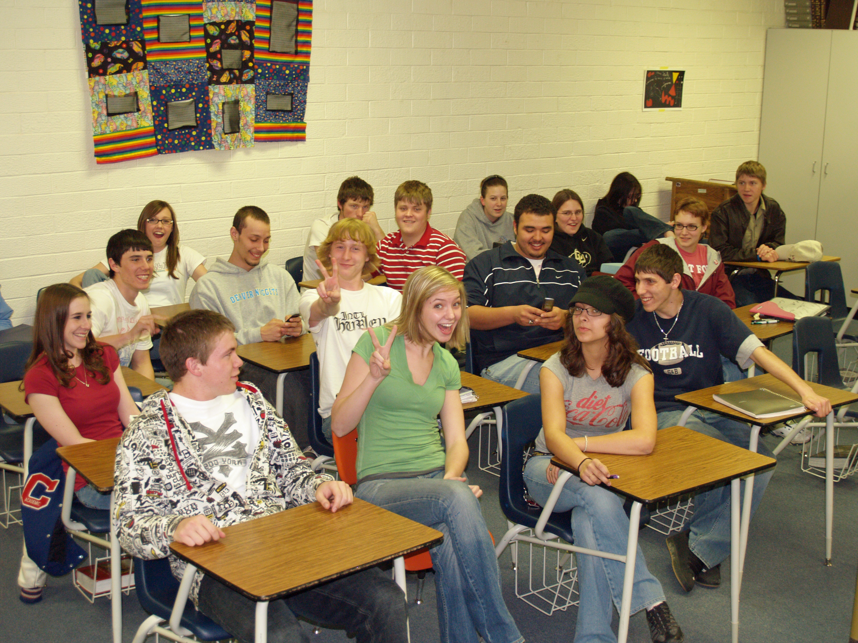
FOUNDATIONS: Settings
Effectively design the physical environment of the classroom.
Arrange furniture to allow for smooth teacher and student movement.

Slide 61
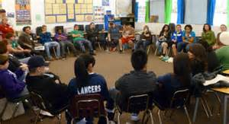
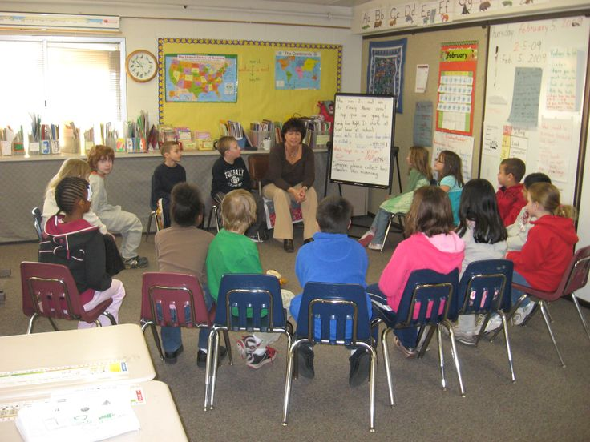
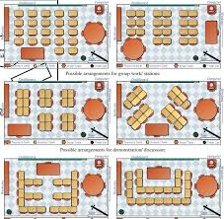
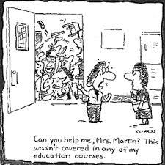
Visibility & Mobility
Notes:
Arrange furniture to allow easy traffic flow
Ensure adequate supervision of all areas
Consider action zone: area of classroom where greatest amount of teacher/student interaction takes place (center of classroom)
Teacher should move through classroom to engage students
Vary seating arrangement for different activities
Consider action zone: area of Rows – front to back
Rows – sides touching
Clusters/small groups
U/Horseshoe shape
Circles

Slide 62
FOUNDATIONS: Settings
Effectively design the physical environment of the classroom.
Assure instructional materials are neat, orderly, & ready for use.

Slide 63
FOUNDATIONS: Settings
Effectively design the physical environment of the classroom.
Post materials that support critical content and learning strategies.

Slide 64
FOUNDATIONS: Routines
Develop and teach predictable classroom routines.
Establish predictable patterns and routines Promote operation of classroom Outline the steps for completing specific activities Teach routines and procedures directly. | Recognize students when they successfully follow classroom routines and procedures. Create routines and procedures for the most problematic areas or times. Promote self-managed or student-guided schedules and routines.
Page 2
Notes:
Barb

Slide 65
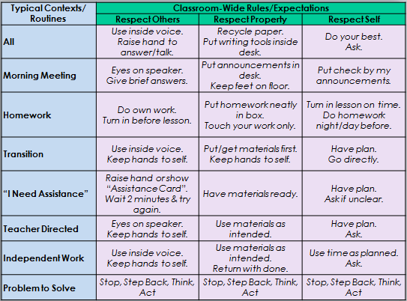
Designing Routines with School-wide Expectations

Slide 66
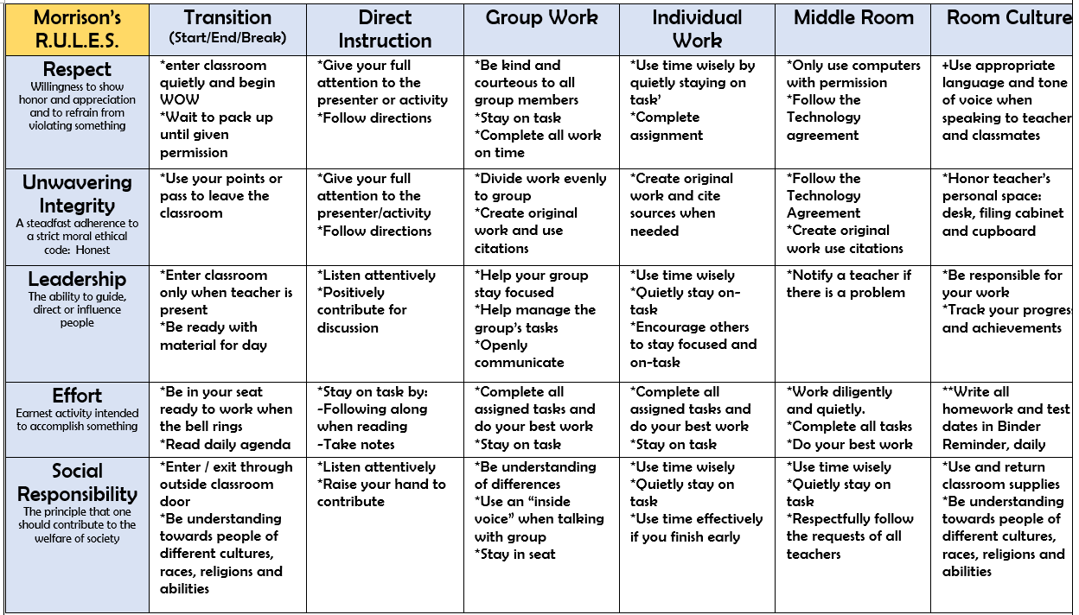

Slide 67
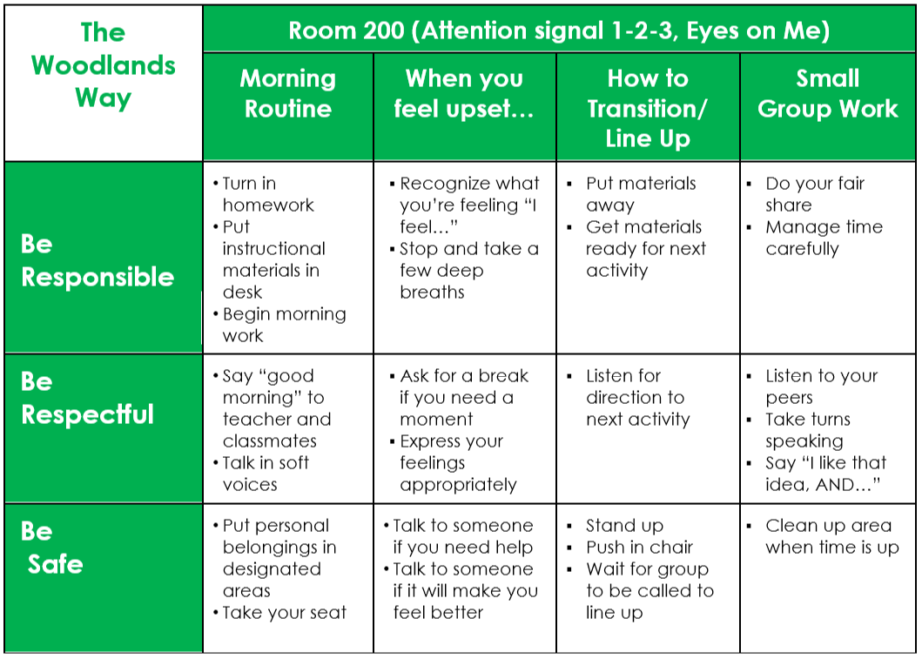
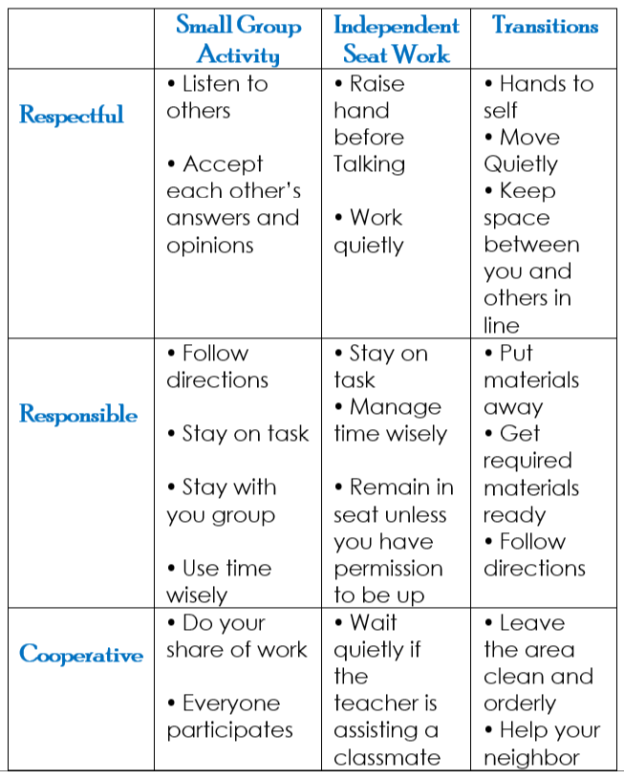

Slide 68
#1
Designing
Your Classroom
Matrix
STEP 1: Frame it
STEP 2: Doing it together
Guidelines: | This means: | Example: | Non-example:
Observable | I can see it | Raise hand and wait to be called on | Be your best
Measurable | I can count it | Bring materials | Be ready to learn
Positively Stated | I tell students what TO do | Hands and feet to self | No fighting
Understandable | The vocabulary is appropriate for age/grade level | Hands and feet to self | Maintain personal space (K_1 rule) *children this age do not have a concept of “personal space.”
Always Applicable | I am able to consistently enforce | Stay in assigned area | Remain seated until given permission to leave
Notes:
Barb: read directions from the book

Slide 69
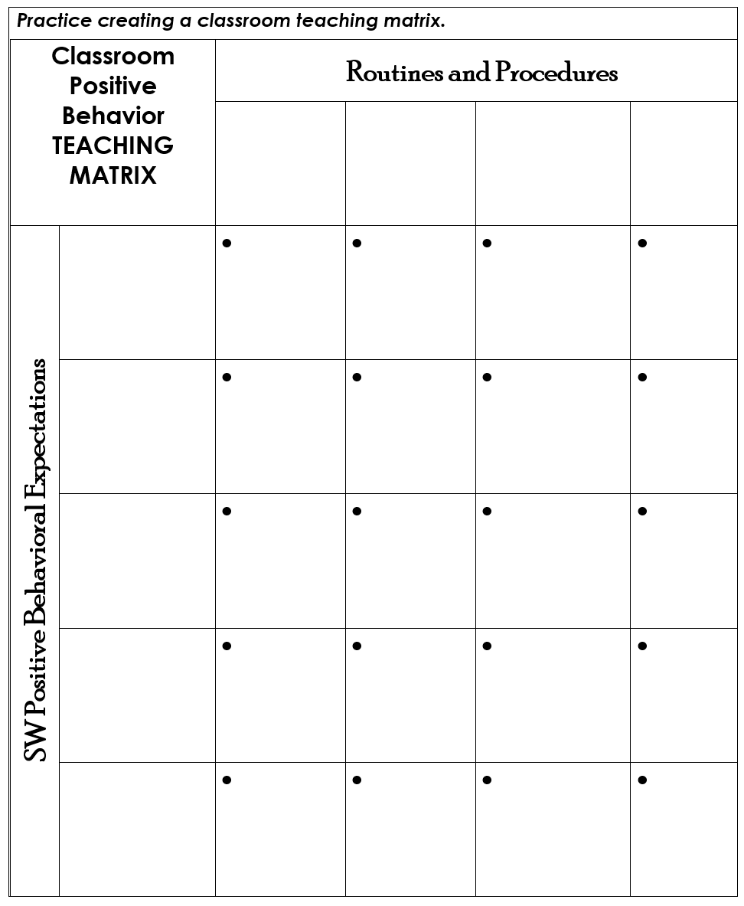
#2
Step 3: Putting
it
all together
Notes:
Poster Paper-Post done and send to lunch
Do as a table, consensus building as a group 10 minutes
Select 3-5 and routines, operationalize

Slide 70
#2
Secondary
Classroom
Routines
Checklist
List all routines implemented in your classroom.
Prioritize where support is needed most.
Start with the routine that is the highest priority.
Identify the desired behaviors replacing problematic behaviors. What should the students DO?
Operationally define steps (See & Hear) so they are clear and consider any errors students are likely to make on these routines.
Include STUDENT VOICE in development of routines and operationally defined steps.
Align routines with Schoolwide Social and Academic expectations.
Describe how you will teach and acknowledge routine.
ROUTINE INTEGRITY
Notes:
If secondary in the room

Slide 71
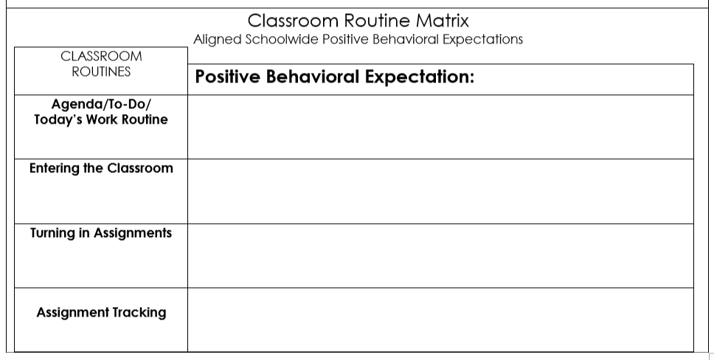
#2
Page 8
Notes:
Barb

Slide 72
Stretch Break
BE BACK AT 2:30

Slide 73
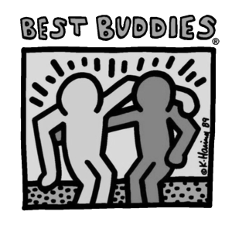
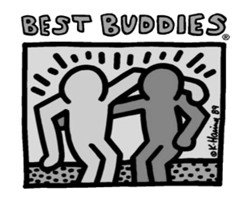
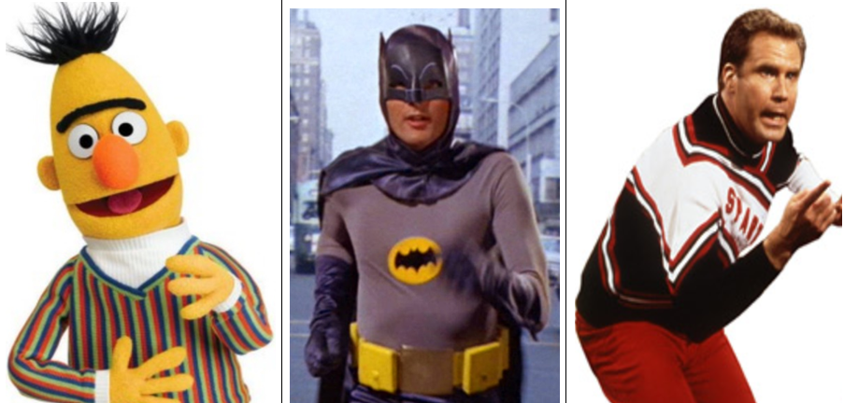
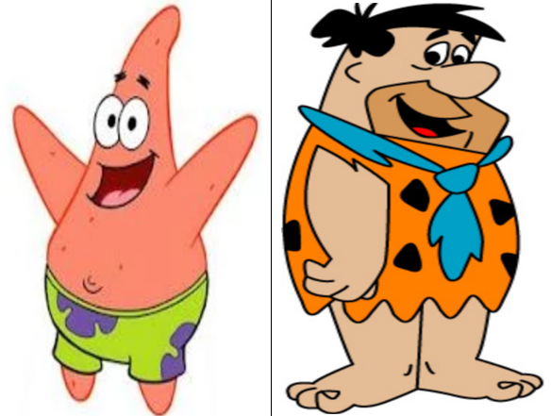
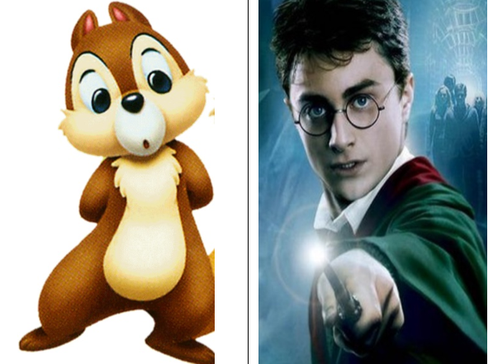
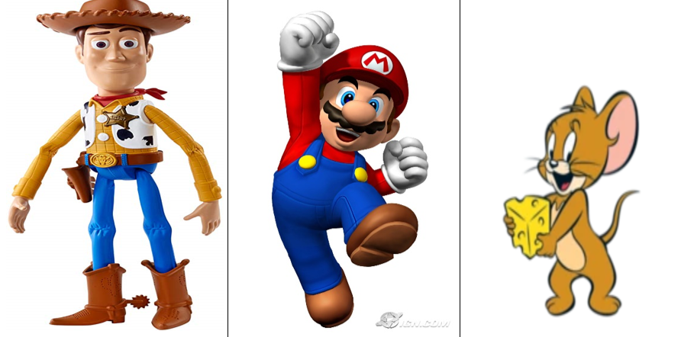
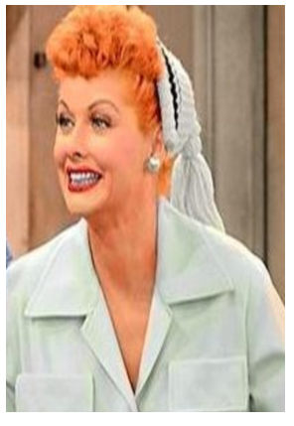
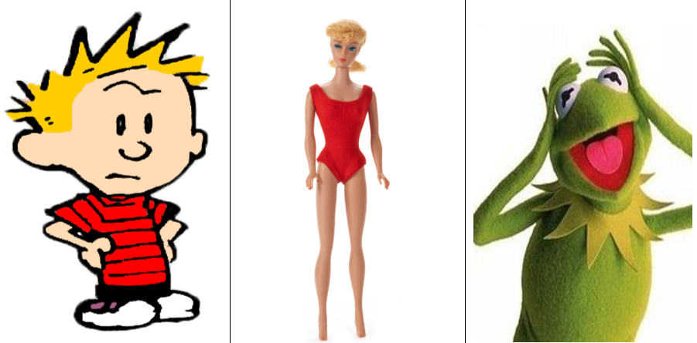
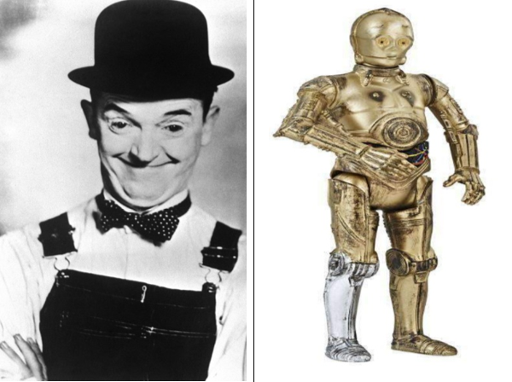
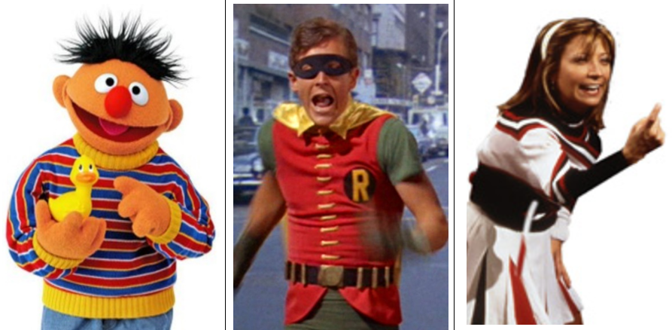
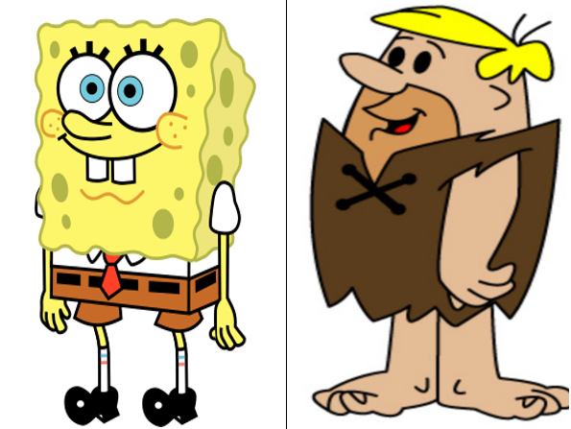
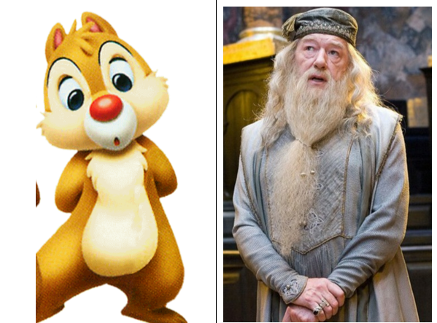
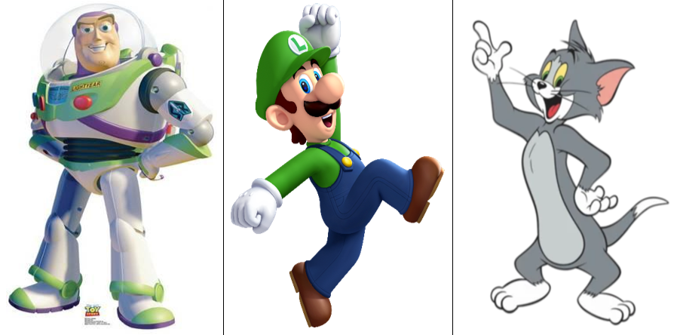
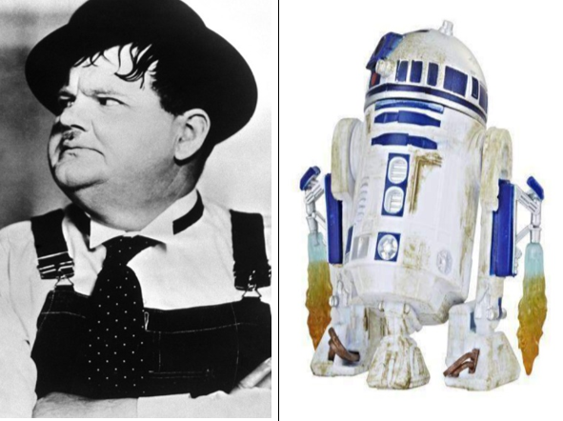
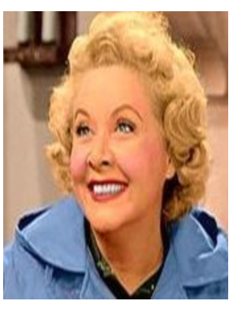
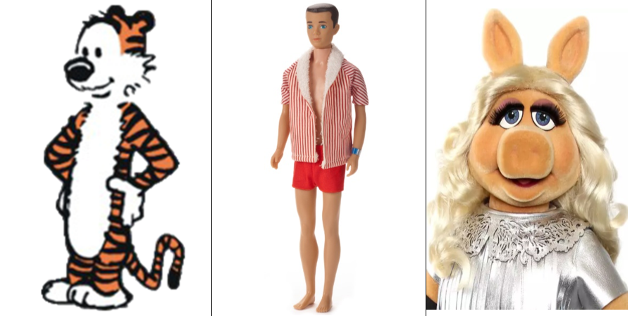
PREVENTION PRACTICES
Find your best buddies!
Share your experience designing classroom routines.
Notes:
Kathy

Slide 74
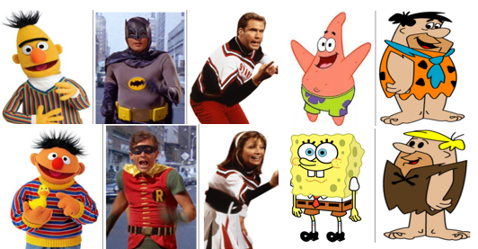
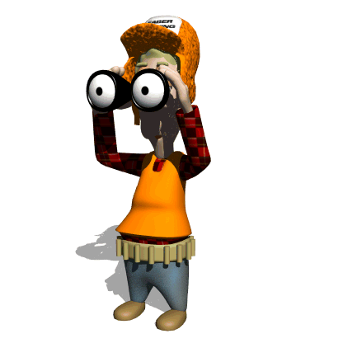
Prevention Practice: Supervision Use active supervision and proximity.
A process for monitoring the classroom, or any school setting, that incorporates moving, scanning, and interacting frequently with students. SCANNING: visual sweep of entire space MOVING: continuous movement, proximity INTERACTING: verbal communication in a respectful manner, any pre-corrections, non-contingent attention, specific verbal feedback
Notes:
Kathy: read WB section reach agreement about what it is and what it isn’t,
Definitions
Examples/Non-Examples
Share your example of supervision-list on the poster paper
Now list the strategies you use and post

Slide 75
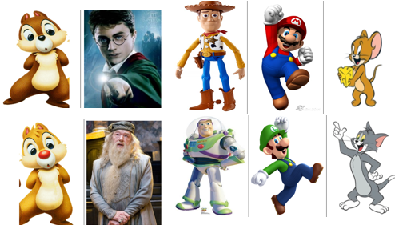
Prevention Practice: Opportunity Provide high rates and varied opportunities.
A teacher behavior that requests or solicits a student response: *INDIVIDUAL OR SMALL GROUP QUESTIONING *CHORAL RESPONDING *NONVERBAL RESPONSES
Notes:
Kathy

Slide 76
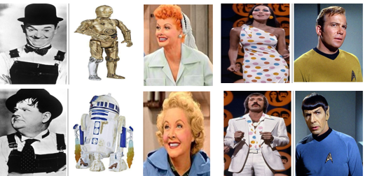
Prevention Practice: Acknowledgement Use behavior specific praise.
Verbal statement that names the behavior explicitly and includes a statement that shows approval: *INDIVIDUAL or GROUP *TIMELY *MEANINGFUL and SINCERE *5 to 1 RATIO
Notes:
Kathy

Slide 77
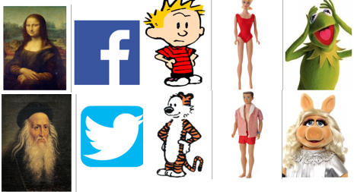
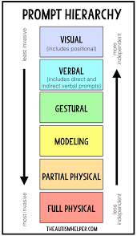
Prevention Practice: Prompts/Precorrects Make the problem behavior irrelevant with anticipaton and reminders.
Reminders that are provided before a behavior is expected that describes what is expected: *PREVENTATIVE *UNDERSTANDABLE *OBSERVABLE *SPECIFIC AND EXPLICIT
Notes:
Kathy

Slide 78
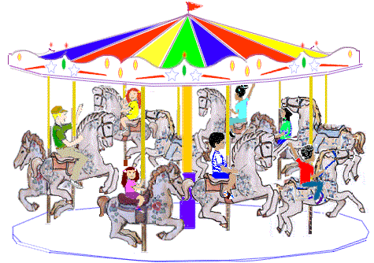
Prevention
Carousel
How are you using this prevention practice in your classroom?
Notes:
Kathy
Move one poster to the right 3 minutes at each poster

